Slide 2
DS-22 Characterization and Dithering for Idle Tones
Carlo Baccigalupi

Slide 3
Outline
DS-22 Metrological Characterization
    Noise and Resolution
    Linearity
    Offset drift and 1-week stability
    Gain drift
Idle Tones
    Triangular Dither
    White Noise Dither

Slide 4
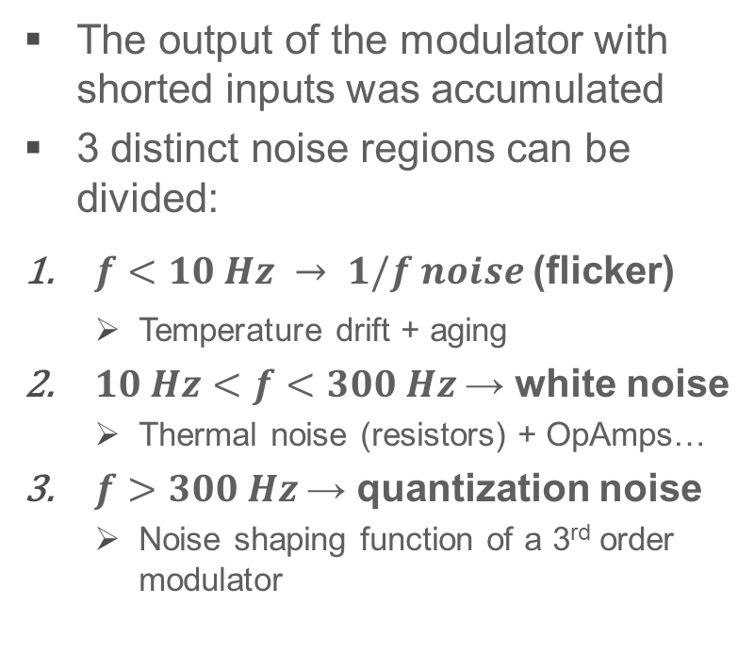
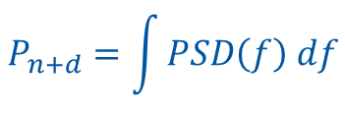
Noise performance
The output of the modulator with shorted inputs was accumulated
3 distinct noise regions can be divided:
$f<10 Hz → 1/f noise$(flicker)
  Temperature drift + aging
$10 Hz<f<300 Hz$→ white noise
  Thermal noise (resistors) + OpAmps…
$f>300 Hz$→ quantization noise
  Noise shaping function of a 3rd order modulator
From the PSD, the power of noise + distortion can be calculated:
$$P_{n+d}=\int{PSD\left(f\right) df}$$

Slide 5

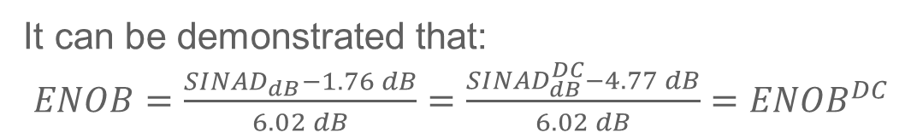
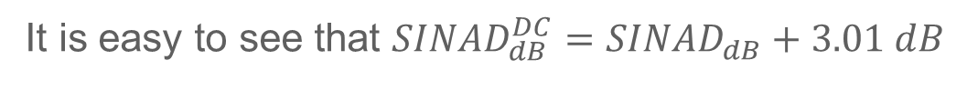

From Noise Power Density to ENOB
According to IEEE 1057-2007:
$${SINAD}_{dB}=10∙{Log}_{10}\left(\frac{{{FS}^{2}}/2}{P_{n+d}}\right)$$
In regulation applications the signal is constant (by definition) thus
With a DC signal at FS:
$${SINAD}_{dB}^{DC}=10∙{Log}_{10}\left(\frac{{FS}^{2}}{P_{n+d}}\right)$$
It is easy to see that ${SINAD}_{dB}^{DC}={SINAD}_{dB}+3.01 dB$
It can be demonstrated that:
$ENOB=\frac{{SINAD}_{dB}−1.76 dB}{6.02 dB}{=\frac{{SINAD}_{dB}^{DC}−4.77 dB}{6.02 dB}=ENOB}^{DC}$
In regulation applications, ${SINAD}_{dB}^{DC}$ is a more interesting figure than ${SINAD}_{dB}$

Slide 6
ENOB vs Bandwidth
3 sudden ENOB drops:
The big drop at 5 Hz is caused by an idle tone. The frequency of the tone depends on the specific unit (offset)
The small drop at 10 Hz is an harmonic of 5 Hz
The last drop at 50 Hz is Electromagnetic Interference (not idle tone)

Slide 7
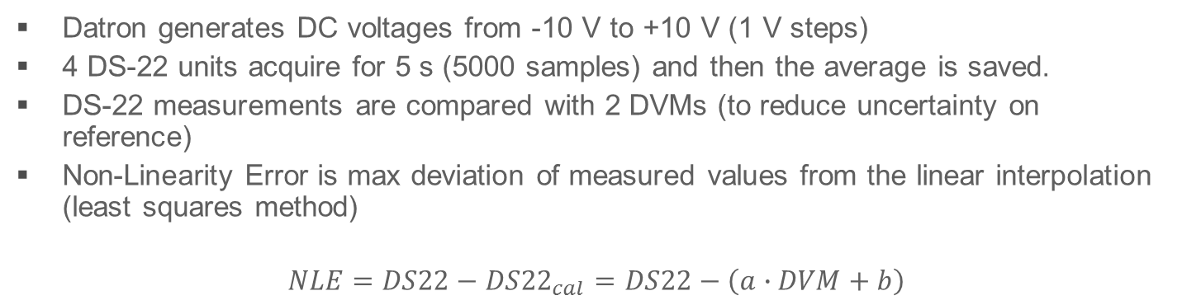

Linearity – Test Setup
Spec for ADC in Class 0 PC
$${NLE}_{max}=±0.8 ppm$$
Datron generates DC voltages from -10 V to +10 V (1 V steps)
4 DS-22 units acquire for 5 s (5000 samples) and then the average is saved.
DS-22 measurements are compared with 2 DVMs (to reduce uncertainty on reference)
Non-Linearity Error is max deviation of measured values from the linear interpolation (least squares method)
$$NLE=DS22−{DS22}_{cal}=DS22−\left(a∙DVM+b\right)$$

Slide 8
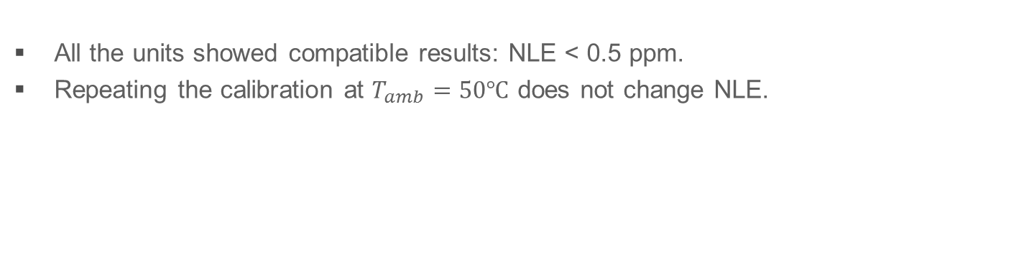
Linearity – Test Results
All the units showed compatible results: NLE < 0.5 ppm.
Repeating the calibration at $T_{amb}=50℃$ does not change NLE.

Slide 9
Offset Drift – Test Setup
Input | Short circuit
Temperature | 30 → 50°C in 12h
Relative Humidity | 40% constant
DS-22 Acquisition | 5s → mean value (every 10 min)

Slide 10
Offset Drift – Test Results (1/2)
O1=-1.1 ppm/°C
O2=0.1 ppm/°C
O3=0.05 ppm/°C
O4*=-0.5 ppm/°C

Slide 11
Offset Drift – Test Results (2/2)
Around 35~40°C all the units change behaviour.
Maybe Peltier is less effective above 40°C?

Slide 12
Offset Stability – Test Results
This test highlights the big improvement obtained on the modified unit in the “hours” time-scale

Slide 13
Gain Drift – 1 unit failed!!

Slide 14
Gain Drift
To assess gain drift, the offset was compensated (point by point)
10 V
Offset
Gain Fluctuations

Slide 15
Gain Drift – Test Results
G2=0.4 ppm/°C
G3=0.1 ppm/°C
G4*=0.5 ppm/°C

Slide 16

Outline
Metrological Characterization
    Noise and Resolution
    Linearity
    Offset drift and 1-week stability
    Gain drift
Idle Tones
    Triangular Dither
    White Noise Dither

Slide 17
Idle Tones (around 0V) – No Dither
Without implementing any dithering, idle tones are simply unacceptable in high-precision applications:
  Very high amplitude
  Lots of harmonics
A similar situation repeats periodically for specific input values. E.g. around 116 mV (SPS injection level)

Slide 18
Idle Tones (around 0V) – Triangular Dither
By introducing a triangular dither, both amplitude and N of harmonics reduce drastically
Triangular dither is characterized by:
  Amplitude (Vpp)
  Frequency (Hz)
In the DS-22:
  A = 1.2 Vpp
  f= 480 kHz or 520 kHz (beating frequency at 20 kHz)
What if we tune it in another way?

Slide 19
Dither Frequency Dependency
Blue: Appears when ADC is fed by 0 V. It directly falls into base-band (≈ 10 Hz) after sampling at 500 kS/s
Magenta: Appears when ADC is fed by ≈ 116 mV (SPS injection level). It falls at ≈ 3 kHz. after filtering and down-sampling at 1 kS/s it folds back to ≈ 400 Hz.
Optimum for Dither frequency = 520 kHz (or equivalently 480 kHz). Not clear why

Slide 20
Dither Amplitude Dependency
There is no optimum for both idle tones at the same time!!

Slide 21
Dither Amplitude Dependency
By increasing the dither amplitude to 1.4 Vpp
> 10 dB worse
> 10 dB better

Slide 22
White Noise Dither
We generate a PRBS at (e.g.) 100 kb/s with an FPGA (few lines of code).
Very good idle tones suppression but increased noise floor above 100 Hz!!!

Slide 23
White Noise Dither
Band-passing the white noise leads to compatible noise floor (except in the 10 kHz – 100 kHz bandwidth which can be filtered in digital).
No spurious tones (20 kHz and harmonics).
No need to tune carefully dither frequency and amplitude (less sensitive).
In this case BOTH 0V and 116 mV Idle tones can be suppressed effectively.
Two active filters have to be used (at least 4th order)

Slide 24
White Noise vs Triangular Dither
0V input
116mV input
In both cases, white noise dither effectively suppress idle tones below the noise floor.
However, a slightly increased noise from 100 Hz to 500 Hz is observed (not critical).

Slide 26
Linearity – Potential Issue

