Slide 1
New High-Resolution ADC Development for HL-LHC
“HPM-7177”
Nikolai Beev
TE-EPC-HPM
26.04.2017

Slide 2
ADC Selection
Preliminary study: tens of commercial ADCs considered (≥24 bits)
EDMS 1845562 v.1 - extended report
conference paper to be presented on 14.05.2018 at I2MTC (Houston, TX)
short list – SAR ADCs by Linear (LTC23xx), AD7177-2
Ongoing tests in a dedicated high-resolution ADC tester
Very good agreement so far

Slide 3
Concept
Compact ADC mezzanine module
Commercial ADC – AD7177-2
Precision scaling amplifier built of ADA4522 and Vishay hermetic R array
Balanced differential inputs for high CMRR
LTZ1000 voltage reference with improved conditioning circuit (Vishay R array)
Excellent thermal management – temperature stabilization at the mK level. Drift <<0.1 ppm/ºC
Local FPGA, bi-directional optical link to FGC
ID, Self-check, diagnostics and self-calibration

Slide 4
Block diagram

Slide 5
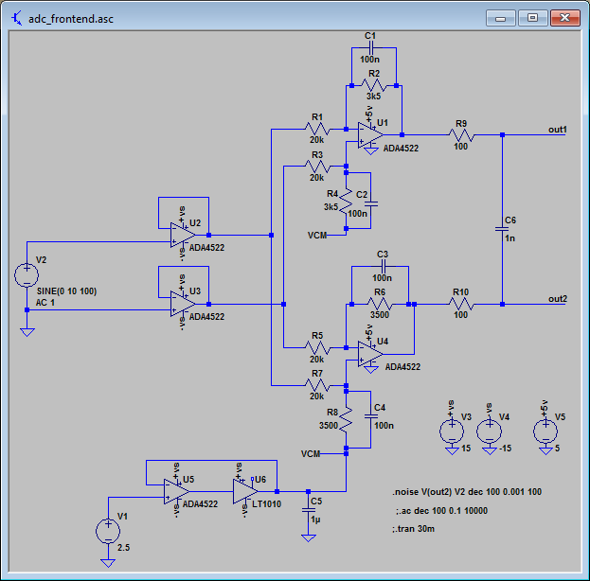
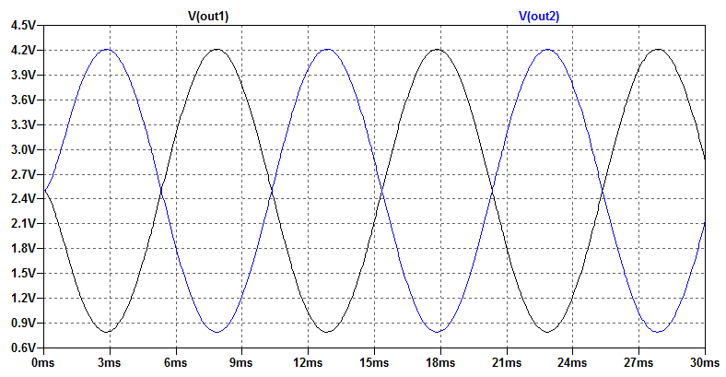
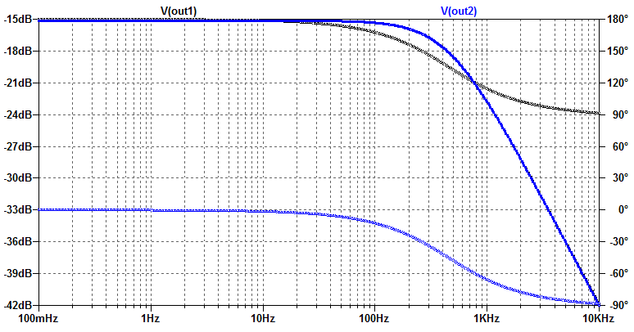
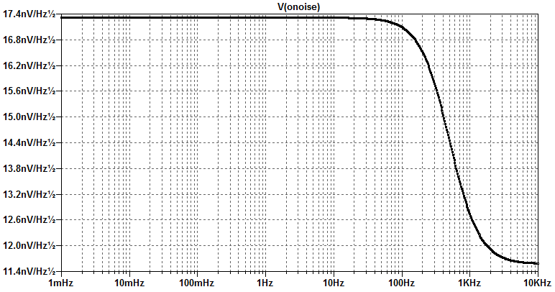
Simulations – Scaling amplifier
Differential
input range
±13.4 V
-3 dB BW
500 Hz
White noise
≈25 nV Hz^{-1/2}
(at differential ADC input)
≈70 nV Hz^{-1/2} RTI (diff.)
lower than ADC noise
The most symmetric circuit possible –
FDA built of separate amplifiers

Slide 6
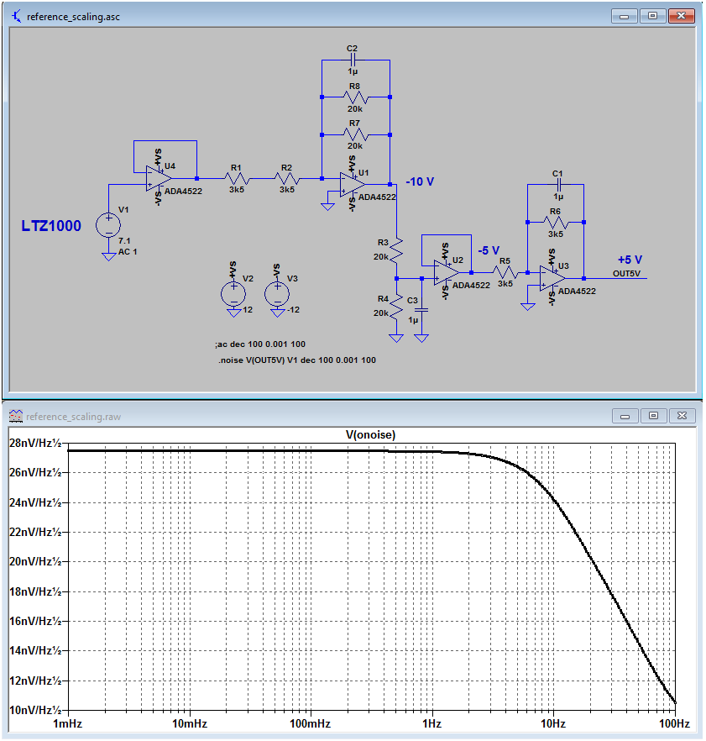
Simulations – Reference scaling
This circuit uses exactly the same
resistor array (3K5-20K) for
scaling the LTZ1000 Zener voltage.
It generates +5V, -5V and -10 V
that can be used for self-calibration
at ±5 and ±10 V
Output noise is lower than the ADC
noise; 1/f will be entirely due to the
LTZ1000.

Slide 7
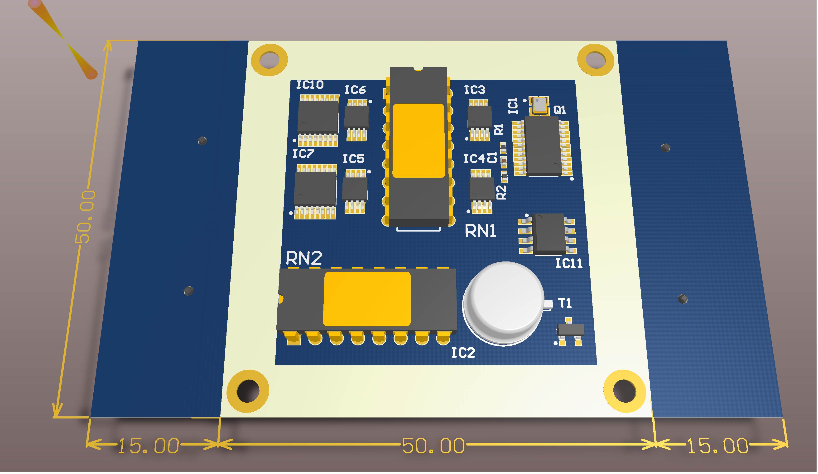
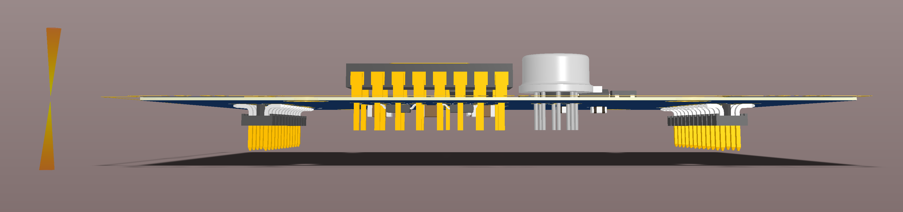
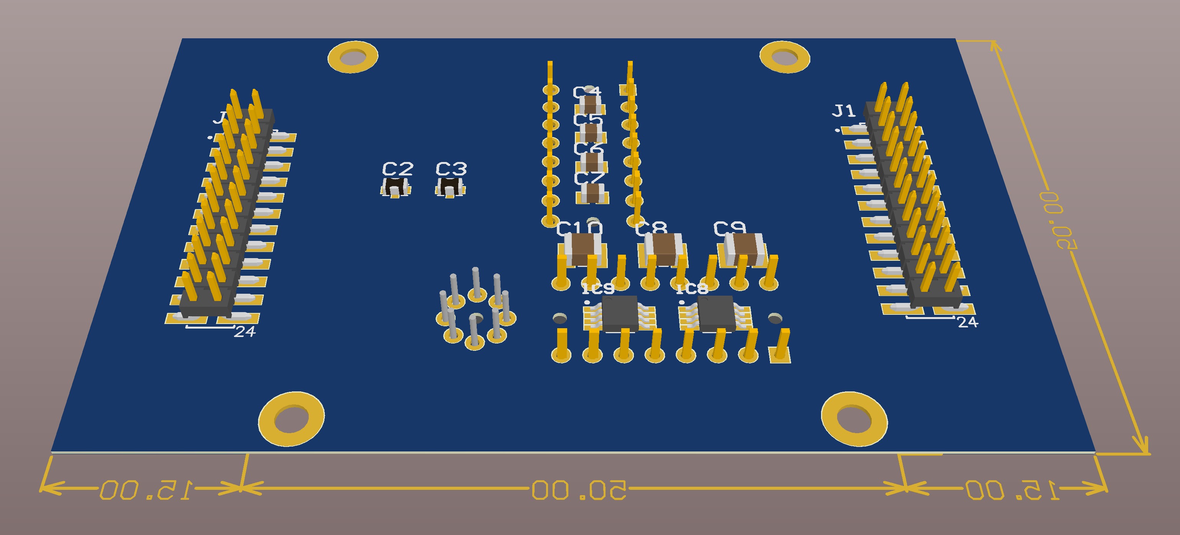
Mock-up design
Top side
ADC, op amps
2x resistor arrays – Vishay 1446
LTZ1000
Temperature sensor (not shown)
Lid/enclosure (not shown)
Side view
R arrays, LTZ1000 and temperature sensor - top surfaces should be flat
Bottom side
More real estate for components; maybe a low-profile shielding lid

Slide 8
Comparison against DS22
(preliminary)
 | DS22 (improved) | HPM-7177
PCB size | 82x145 mm | 50x70 mm
Number of components | >220 | <80
Idle tones | <130 dBFS around 0V | none
Inputs | Pseudo-differential, non-balanced | Fully differential, balanced
Offset/gain drift | <0.1 ppm/°C | <0.01 ppm/°C
RTI noise (>10 Hz) | 200 nV Hz^{-1/2} | 140 nV Hz^{-1/2}
RTI noise (<1 Hz) | 300 nV Hz^{-1/2} | 140 nV Hz^{-1/2}
Self-calibration, remote diagnostics, etc. | no | yes
Design documentation | CERN only | open under CERN OHL

